Slide 1

E-commerce-transaction-purchasing-analysis
This project analyzes factors influencing customer purchasing behavior.

Slide 2
Data source:
The data used in this project is from kaggle.com (https://www.kaggle.com/datasets/smayanj/e-commerce-transactions-dataset?resource=download)
Data structure:
Columns:
Transaction_ID – Unique identifier for each transaction
User_Name – Randomly generated user name
Age – Age of the user (18 to 70)
Country – Country where the transaction took place (randomly chosen from 10 countries)
Product_Category – Category of the purchased item (e.g., Electronics, Clothing, Books)
Purchase_Amount – Total amount spent on the transaction (randomly generated between $5 and $1000)
Payment_Method – Method used for payment (e.g., Credit Card, PayPal, UPI)
Transaction_Date – Date of the purchase (randomly selected within the past two years)

Slide 3

Methodology
Data Preparation – Cleaned and preprocessed data using pandas and numpy.
EDA & Analysis – Used seaborn, matplotlib, and statsmodels for visualization and statistical insights.
Feature Engineering & Splitting – Selected key features and split data for training/testing.
Predictive Modeling – Applied Logistic Regression, Linear Regression, and Random Forest, evaluated with sklearn.
Visualization – Created interactive dashboards in Power BI to present insights.

Slide 4

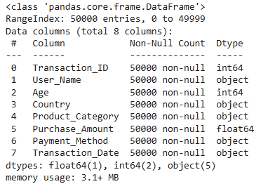
Data set information

Slide 5
Data type changing
01
Transaction_Date
Convert from object type to the format of date and time
02
Luckily
There are no missing data in this data set

Slide 6


Numerize the "Product_Category", "Payment_Method" columns
Add new boolean columns to indicate the features of 'Product_Category' and 'Payment_Method'

Slide 7
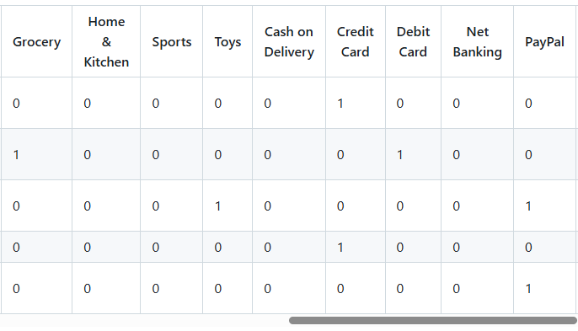
New boolean columns example

Slide 8
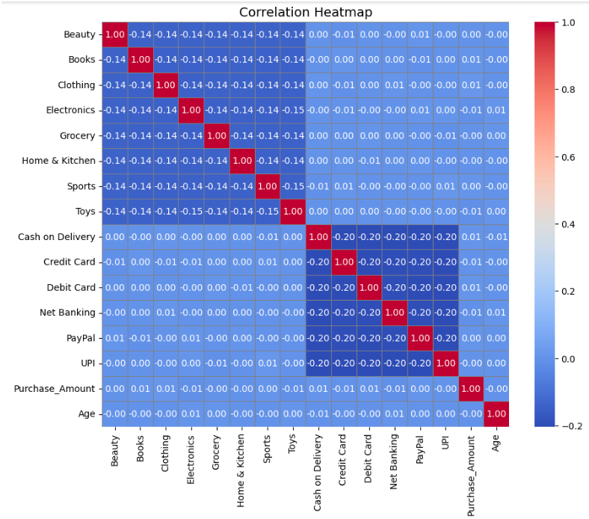
Correlation checking
At this step, I selected all the numeric columns for analysis, excluding the country-code column. Although country-code is numerical, its values do not have a meaningful order or impact on correlations.

Slide 9

Slight positive correlations were observed with Clothing, Books, and Sports, suggesting that spending in these categories is linked to marginally higher purchase amounts.
Weak negative correlations were noted for Electronics and Toys, indicating they might slightly lower total spending.
Payment methods also showed minor trends: Cash on Delivery and Debit Card had slight positive correlations, while Credit Card and Net Banking had weak negative correlations.
Overall, no single factor strongly influenced Purchase_Amount, suggesting the need for further analysis to uncover key drivers of customer spending behavior.

Slide 10
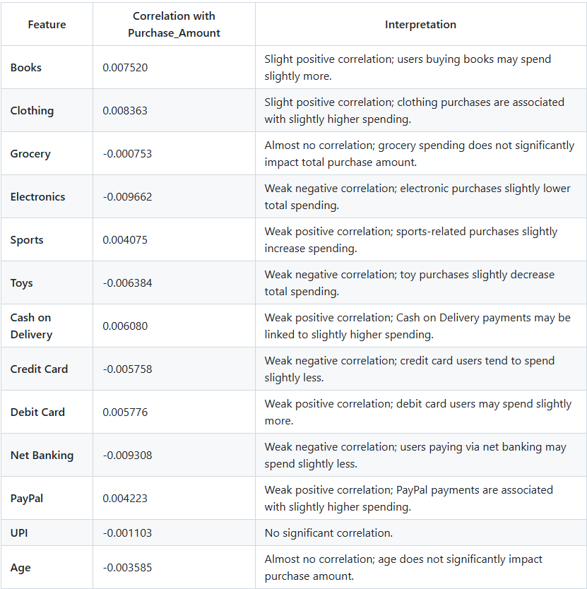

Slide 11
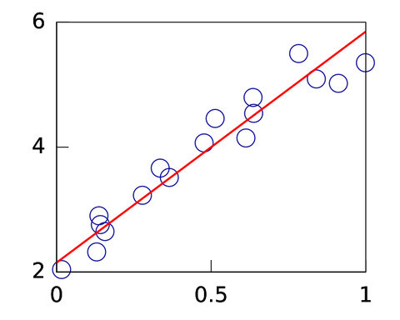

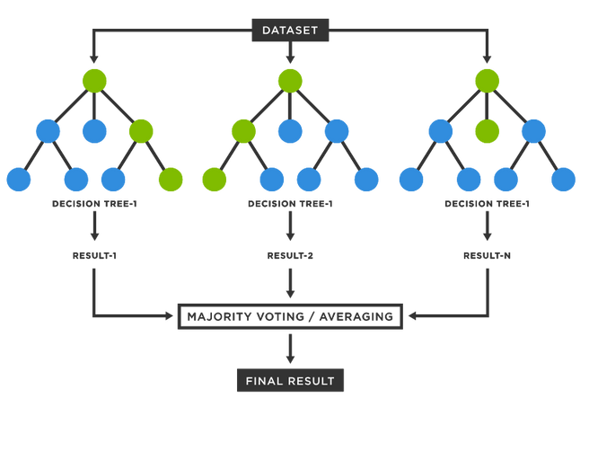
Prediction models
Linear Regression model
Logistic Regression model
Random Forest model

Slide 12
Logistic Regression model testing
01
Purpose
The goal is to test whether variables such as payment method, product category, and age influence the purchase amount
02
80 - 20
Use 80% of the data for training and the remaining 20% for testing
03
Important indicators
Pseudo R-squared, LLR p-value

Slide 13
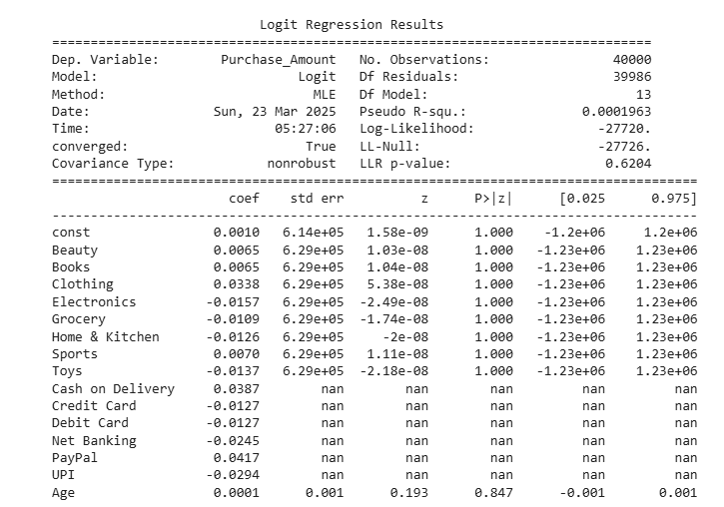
However, the result was not as expected

Slide 14


Pseudo R-squared: 0.0001963 → This is very low, meaning the model explains almost none of the variability in Purchase_Amount.
LLR p-value: 0.6204 → A high p-value suggests that the overall model is not statistically significant.

Slide 15

The next model to be applied for testing is Linear Regression

Slide 16
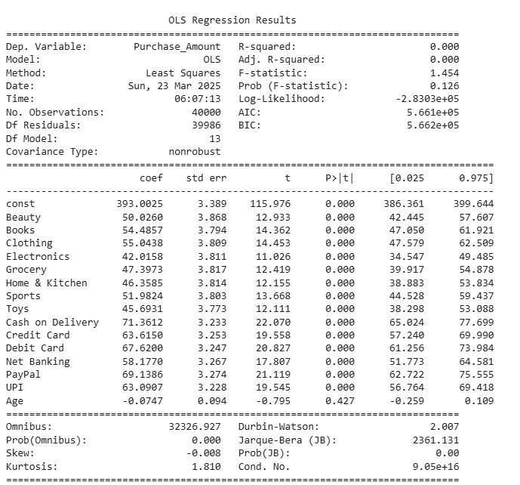
In the linear regression model, I use the same variables as in the logistic regression model to examine their effect on the purchase amount.

Slide 17
However, the results are still not very promising
R-squared: 0.000 → The model explains virtually none of the variance in Purchase_Amount, meaning that the independent variables do not effectively predict purchase amount.
Adj. R-squared: 0.000 → Adjusted for the number of predictors, the explanatory power remains insignificant.
F-statistic: 1.454 (p-value = 0.126) → The overall model is not statistically significant, meaning the predictors collectively do not explain variations in purchase amount.

Slide 18
The next model to be applied for testing is Random Forest

Slide 19
In this model
I did also split the data
100 decision trees are made
Each tree will learn something slightly different, and their combined results will be averaged to make the final prediction
Data is split into 80% for training and 20% for testing

Slide 20

However, the results are still not as positive as expected

Slide 21
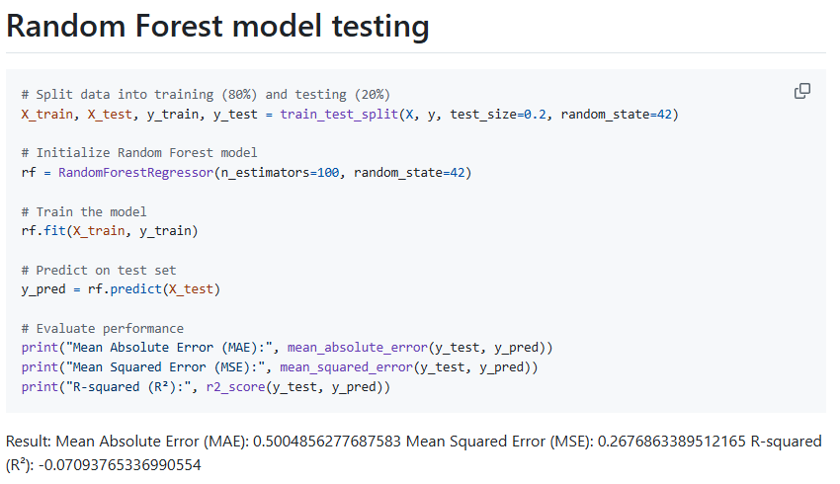

Slide 22
R-squared (R²): -0.0709
This is a major concern. A negative R² means the model performs worse than simply predicting the average purchase amount for every observation.
Ideally, R² should be close to 1 (which means a strong ability to explain variations in purchase amount).
A negative R² suggests that the Random Forest model does not effectively capture patterns in purchase amount based on the given features.

Slide 23

I've decided to use Power BI to visualize the data for a clearer and more insightful understanding

Slide 24
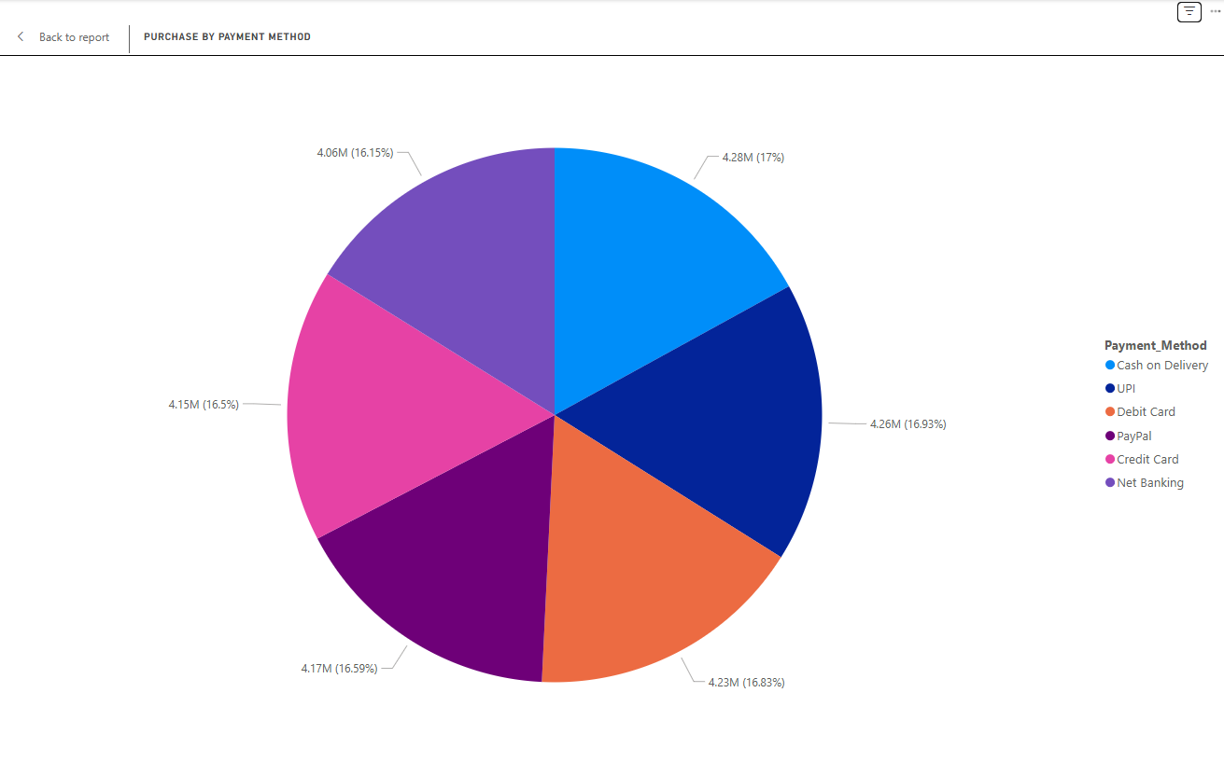

Slide 25
At first glance, the distribution of Payment Method and Product Category based on Purchase Amount appears quite similar, making it difficult to extract meaningful insights from their differences.

Slide 26
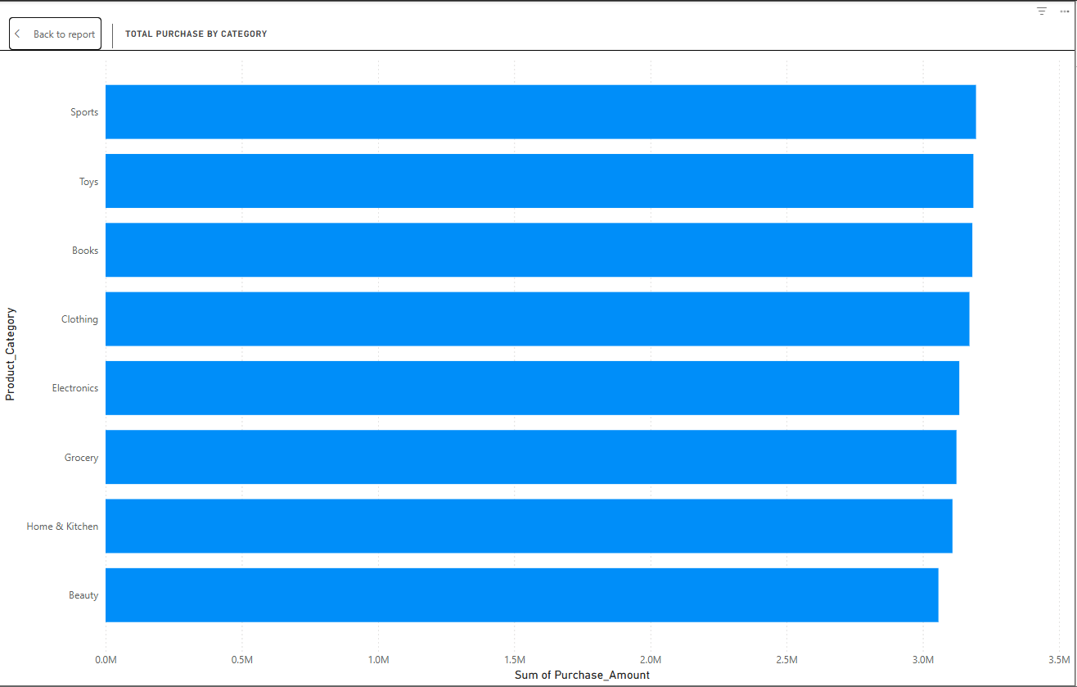

Slide 27
Additionally, for each product category, the total purchase amount is consistent across all categories

Slide 28
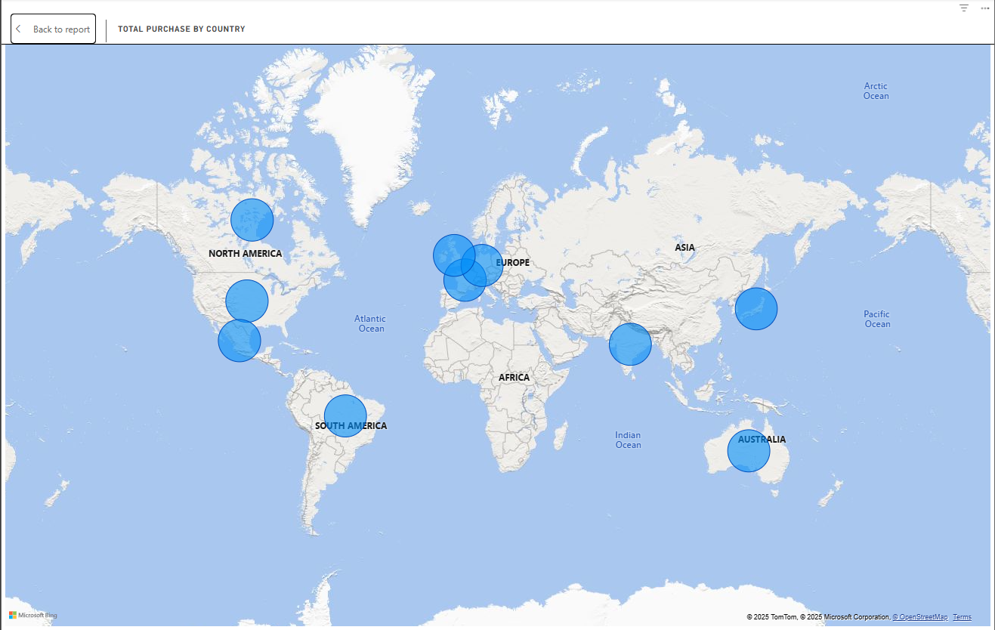

Slide 29
The purchase amount is identical across all countries

Slide 30
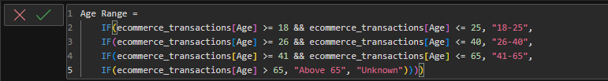
It was truly challenging, as all the data seemed manipulated. Suddenly, an idea struck me—I decided to examine the customers' ages and categorize them into segments

Slide 31
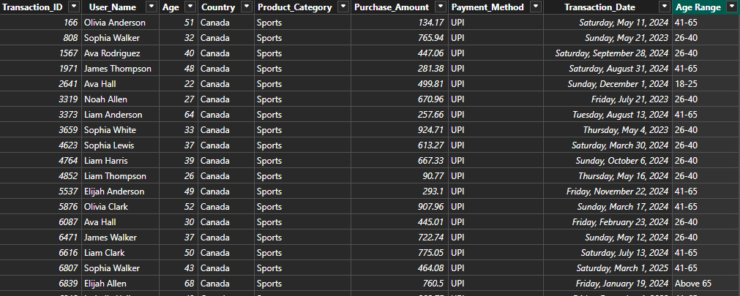

Slide 32
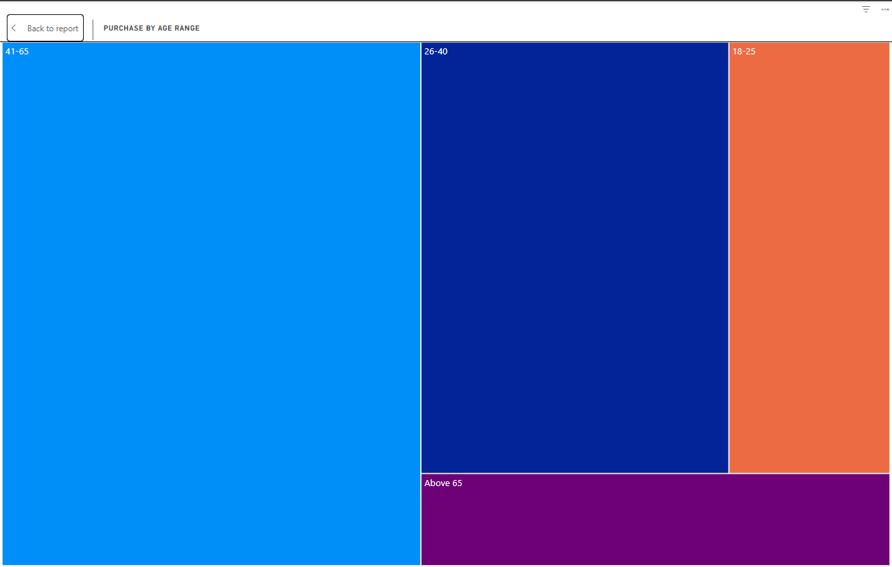

Slide 33
There is a noticeable difference in spending power across different age groups.
Among them, the group aged 41 to 65 makes up the majority, followed by the group aged 26 to 40, then the group aged 18 to 25, and finally, the group over 65 (which can be understood as retirees).

Slide 34
Next, I delved into their spending habits by examining the product categories they purchased and how it changed over the years

Slide 35
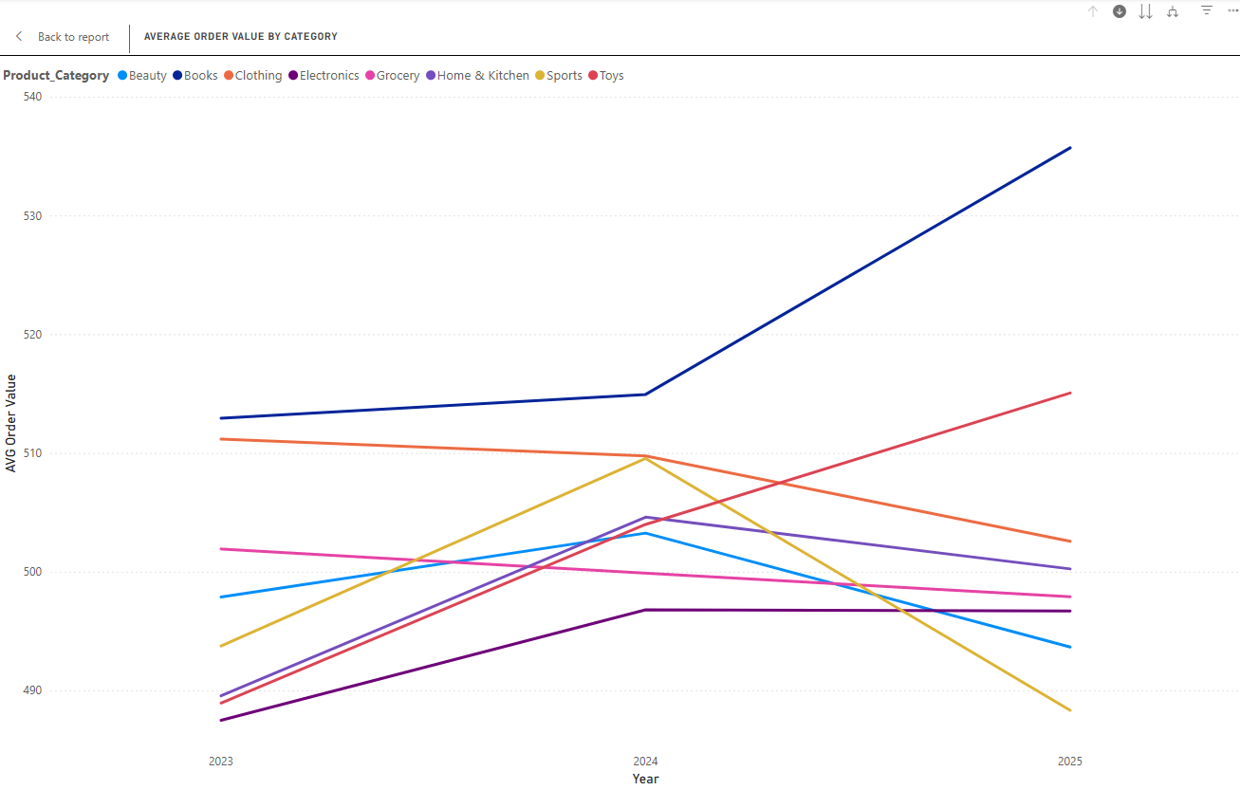
Customers aged 41 - 65 purchase amount on each category

Slide 36
Observation on purchase behaviors of customers from age 41-65
The Books category stands out as the leading preference, showcasing the fastest growth rate among all segments. Interestingly, Toys emerge as the second most appealing category for this demographic, maintaining steady growth in average order value over time.

Slide 37
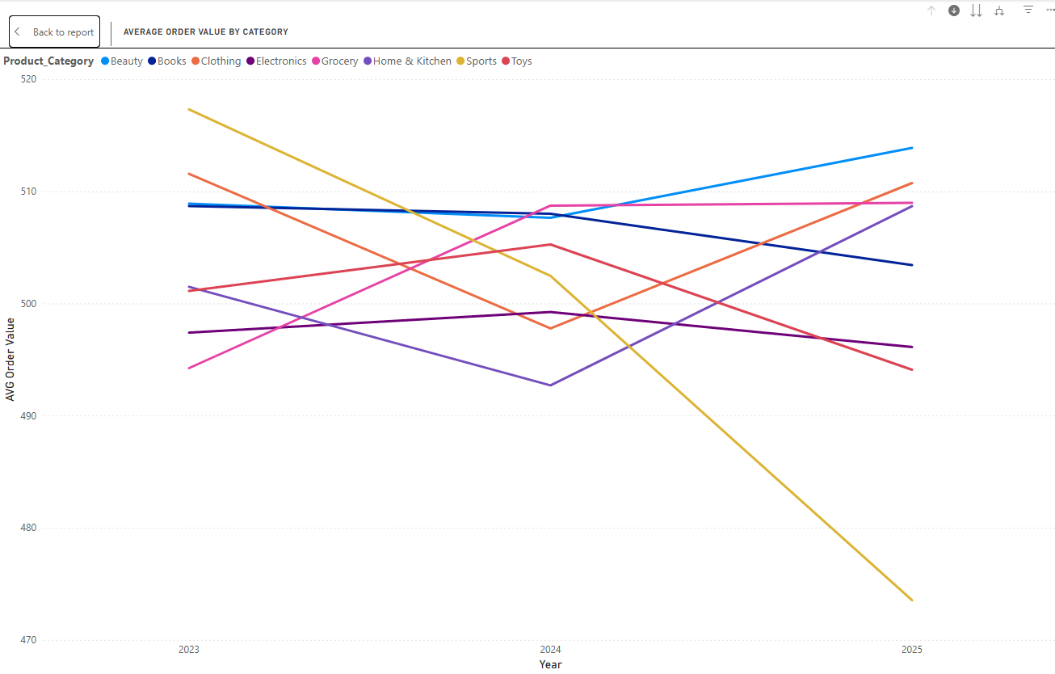
Customers aged 26 - 40 purchase amount on each category

Slide 38
Observation on purchase behaviors of customers from age 26-40
Most categories have shown no significant change over time, except for Sports, which has declined dramatically over the past three years

Slide 39
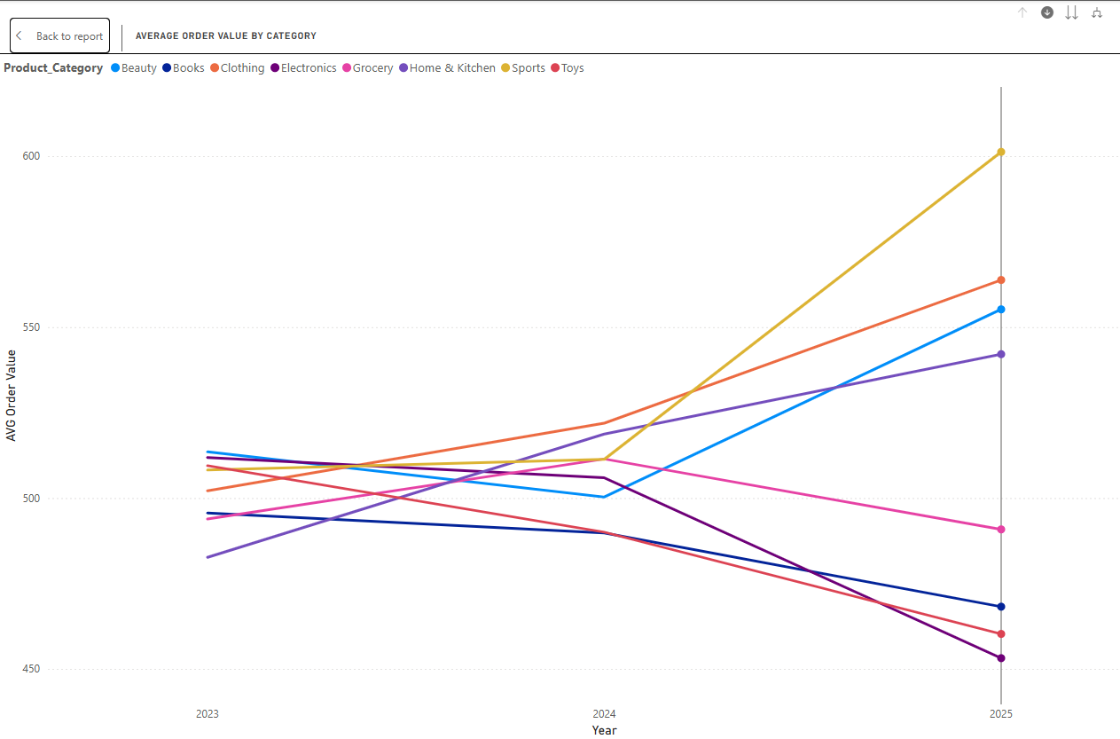
Customers aged 18 - 25 purchase amount on each category

Slide 40
Observation on purchase behaviors of customers from age 18-25
In contrast to the 26–40 age group, young consumers aged 18–25 show a growing trend in purchasing Sports, Clothing, Electronics, and Beauty products, while other categories have declined in average order value.

Slide 41
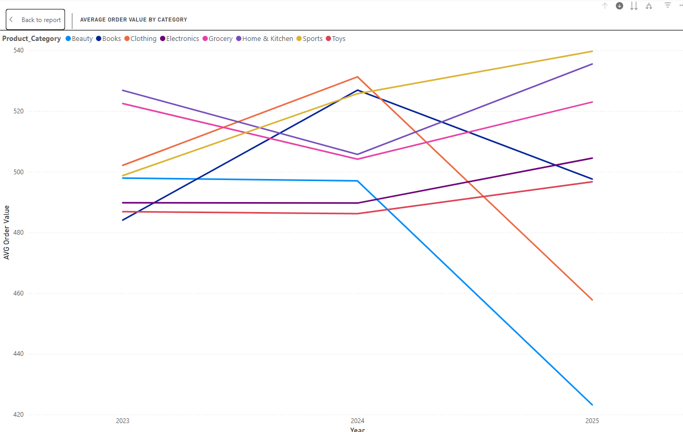
Customers aged above 65 purchase amount on each category

Slide 42
Observation on purchase behaviors of customers from age above 65
In the 65+ age group, the focus is primarily on purchasing Sports, Electronics, and Grocery products.

Slide 43
General conclusion
Dominant Customer Segment
The 41–65 age group contributes the most to overall revenue, making them a crucial target audience.
Within this group, Books and Home & Kitchen drive significant revenue, with Books showing the highest growth rate.

Slide 44
Shifting Category Preferences by Age
26–40 age group: Stable purchasing behavior, except for Sports, which has declined sharply.
18–25 age group: Growing interest in Sports, Clothing, Electronics, and Beauty, while other categories are losing traction.
65+ age group: Focused on Sports, Electronics, and Grocery, indicating demand for practical and entertainment-related products.

Slide 45
Category Growth Trends
Home & Kitchen experienced the fastest-growing average order value over the past three years, signaling an opportunity for further expansion.
Toys are gaining steady traction among the 41–65 age group, suggesting a potential market for gifts or family-oriented purchases.
Sports category decline among 26–40-year-olds may indicate shifting interests, requiring strategy adjustments.

Slide 46
Recommendations for E-Commerce Business
Prioritize High-Value Customer Segments
Focus marketing efforts on the 41–65 age group, as they generate the most revenue.
Enhance promotions for Books and Home & Kitchen products, leveraging their high growth.

Slide 47
Optimize Product Strategies by Age Group
18–25: Invest in targeted promotions for Sports, Clothing, Electronics, and Beauty products through influencer marketing and social media campaigns.
26–40: Investigate the reasons behind the decline in Sports sales and consider repositioning or bundling strategies.
65+: Improve the shopping experience for Sports, Electronics, and Grocery categories, possibly with loyalty programs or senior-friendly promotions.

Slide 48
Leverage Seasonal & Personalized Marketing
Offer personalized recommendations based on purchase behavior, especially for the 41–65 segment.
Run seasonal discounts and bundled offers for high-growth categories like Home & Kitchen and Toys.

Slide 49
Address the Declining Categories
Conduct deeper analysis on why Sports is declining in the 26–40 group. Consider repositioning it with fitness trends or home workout solutions.
Identify declining categories in the 18–25 group and explore product innovation or rebranding.

Slide 50
End

